Slide 1
Machine Learning for MicroRNA Biomarkers of Renal Carcinoma
Zara Thalji

Slide 2
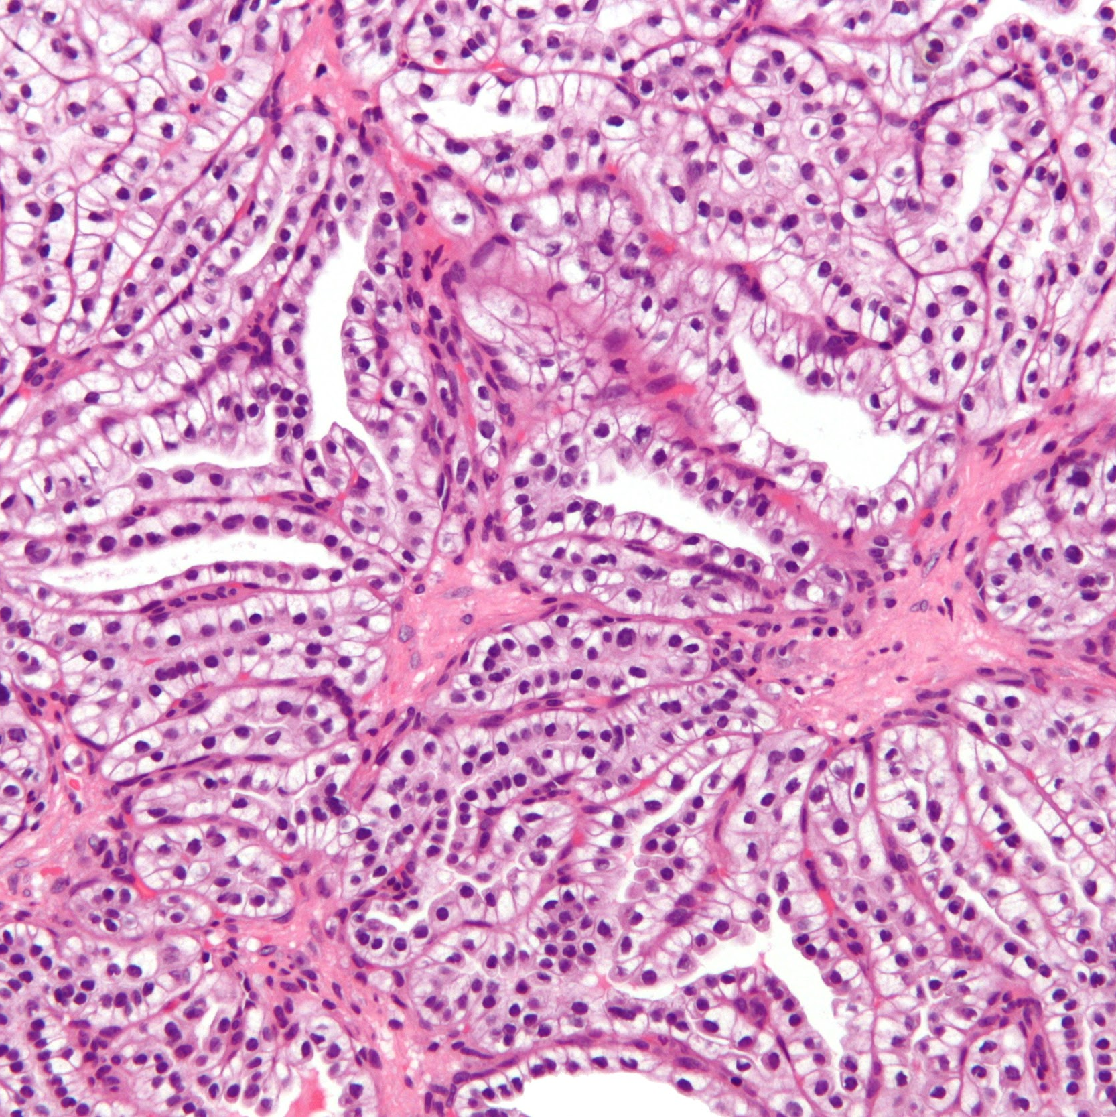
Purpose
Machine learning algorithms will be applied to the databases of healthy and renal cell carcinoma tissue to determine a new downregulated or upregulated microRNA biomarker, from which the diagnostic and therapeutic application will be tested.

Slide 3

The Research Before This….
Machine learning: When computers learn from data to discern patterns with either supervised, unsupervised, or reinforcement algorithms
MicroRNA: non-coding, tiny RNAS that target messenger RNAS to regulate gene expression
Repetitive regulatory network patterns that exist in gene regulation which microRNA is involved in can be coded for
Notes:
Advantage of using computer modeling:
Able to distinguish between subtypes, circulating microrna is hard to determine experimentally but is incredibly useful in tracking the progression of cancers by distinguishing stages
Of course can account for the heterogeneity among samples and provide statistically sound evidence of microrna biomarkers

Slide 4
The Research Before This….
How MicroRNA helps with therapy
miR-128 was associated with a subtype of leukemia and found to create DNA damage when overly expressed in cells (Wang et al., 2018)
Higher miR-155-5p in pancreatic ductal adenocarcinomas was shown to have chemo resistance and poor prognosis for gemcitabine treatment (Hernandez & Lucas, 2016)
Renal Cell Carcinoma: Malignant cancer of the kidneys with various genetic and biological factors dividing it into types
Lou et al. in 2017 found that miR-144-3p was a novel plasma diagnostic biomarker through microarray experimentation for clear cell renal carcinoma
Our Cancer of Research
Notes:
There is evidence to suggest that what was found to be a diagnostic microRNA of cancer can also be determined to have significant impacts on the effectiveness of patients’ treatments.
Subtypes of renal cell carcinoma: clear cell, multicular, papillary, chromophobe, collecting duct, renal mudullary, and mucinous tublar. No biomarker has been researched into for various subtypes of renal cell carcinoma, which is why machine learning is so necessary.

Slide 5
What’s new...
Tests therapeutic over or under expression
Diagnostic MicroRNA
Computer Modelling to find biomarkers
Only 1 known microRNA biomarker of renal carcinoma
No computer modeling has found microRNA biomarkers of renal cell carcinoma
Tests the diagnostic and therapeutic ability of the microRNA

Slide 6
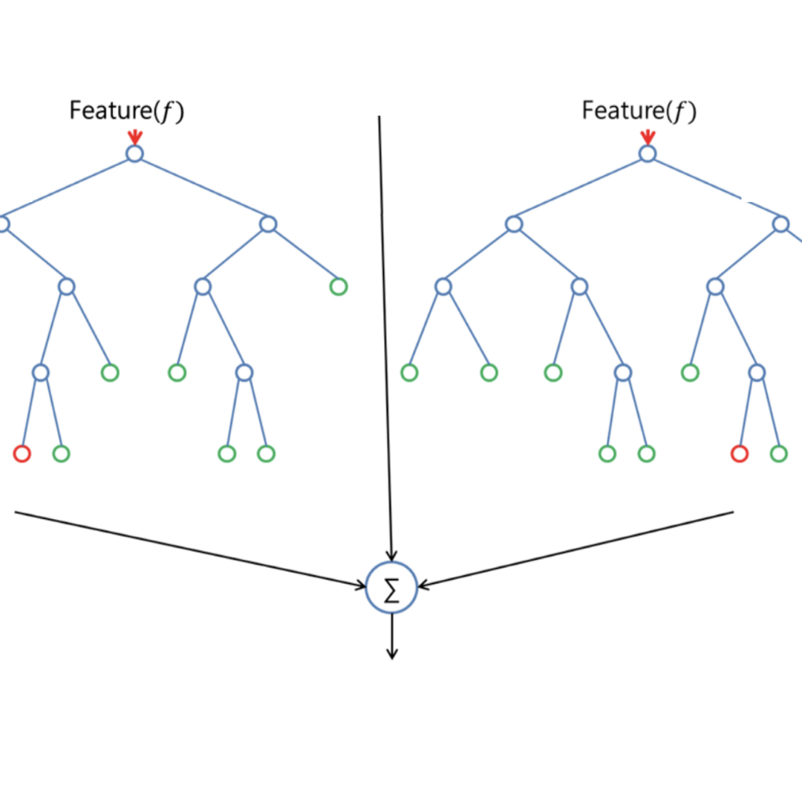
The Plan
Use either PicTAR or random forest algorithms to comb through dbDEMC 2.0 and the miRCancer databases
Senior Year: Find possible biomarkers and determine their existence in lab with CRL-1932 cell line
Modify the expression of microRNA depending on whether it’s up or down regulated
Notes:
dbDEMC 2.0: database of diffretnitally expressed microRNAS in human cancers
209 expression profilingss, 36 cancer, 73 subtypes, and 2224 microrna identifie
MiRCANCer docuemnts 578 relationshipbs between 236 microRNAS and 79 cancers

Slide 7
WHY IS THIS IMPORTANT?
Renal Cell Carcinoma:
has no previous machine learning applications
19%, 26%, 47%, and 92% mortality rate for stages I, II, III, & IV
Therapeutic ability could have implications for the entire field of cancer research
Notes:
In the Us, more than 200,000 people are thought to be living with renal carcinoma

Slide 8
Thanks!
ANY QUESTIONS?

Slide 9
References
Hernandez & Lucas, (2016). Novel microRNA biomarker of in pancreatic ductal adenocarcinomas . Journal of Public Health, 11, 105-115. doi:10.1759-796-12
Lou N., Ruan A.M, & Qui B. (2017) miR-144-3p as a novel plasma diagnostic biomarker for clear cell renal cell carcinoma. Urol Oncol, 109, 36-37. doi: 10.1016
Wang, Z., Michalski, S. G., , Durka, W. (2018). miR-128 effect on the DNA damage of leukemia. Journal of Public Health, 10, 213-221. doi:10.1128%2FJVI.02386-12

